Slide 1
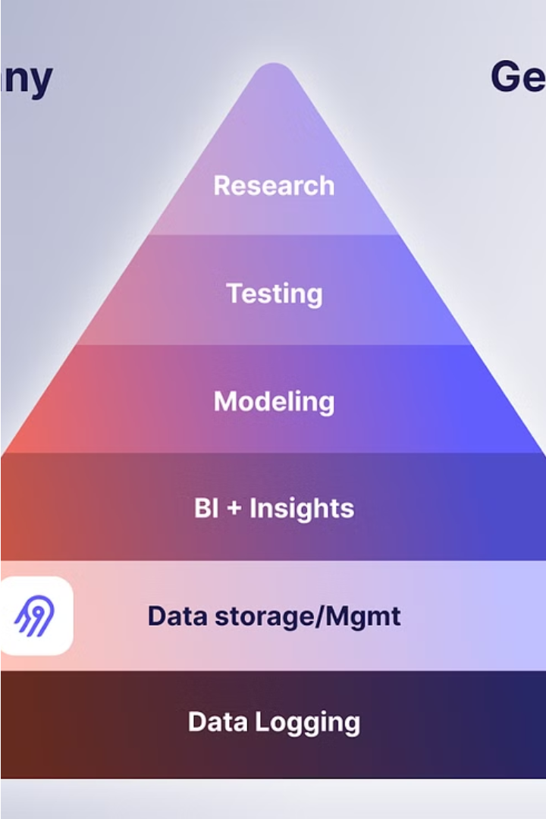

Introduction to K-Nearest Neighbors (KNN)
KNN is a powerful machine learning algorithm used for classification and regression tasks. It works by identifying the k nearest data points to a new input and using their labels to make a prediction. KNN is intuitive, versatile, and can handle nonlinear relationships in data.

Slide 2
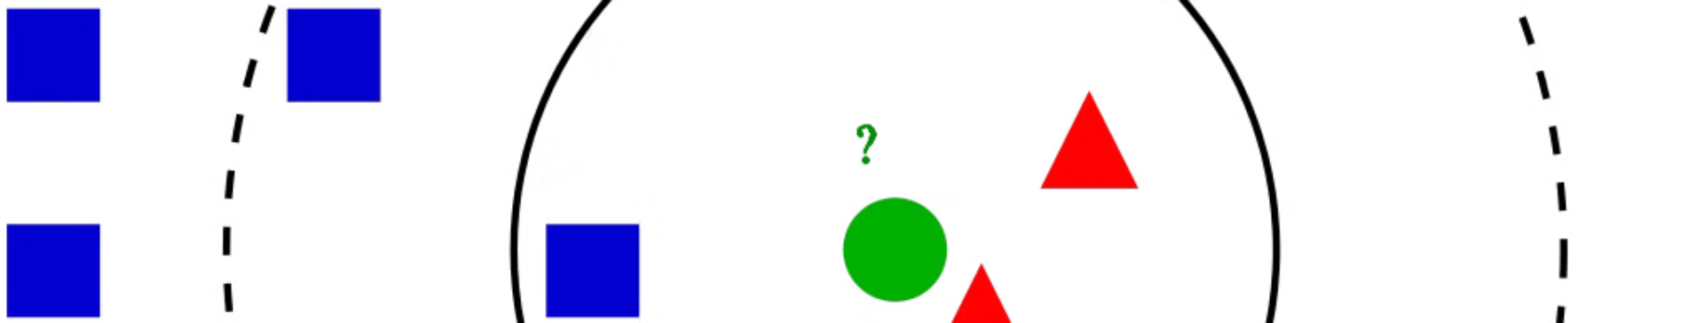
Understanding the KNN Algorithm
1
Identifying Neighbors
2
Voting for Classification
3
Averaging for Regression
KNN calculates the distance between a new data point and all existing points, then selects the k closest neighbors.
For classification tasks, KNN assigns the new point the label that appears most frequently among the k neighbors.
For regression, KNN predicts the new point's value as the average of its k nearest neighbors' values.

Slide 3
Preparing Data for KNN
Feature Scaling
Handling Missing Values
Dimensionality Reduction
KNN is sensitive to the scale of features, so data should be standardized or normalized.
KNN can be applied to datasets with missing values by imputing the missing data.
Applying techniques like PCA can improve KNN's performance on high-dimensional data.

Slide 4
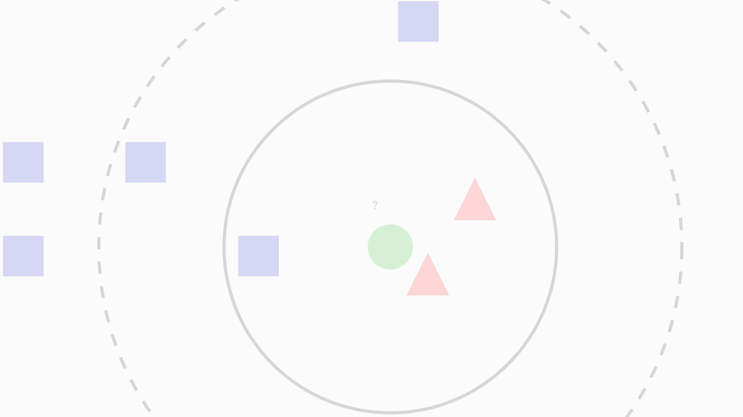
Selecting the Optimal K Value
K=1
1
Overfitting - the model memorizes training data and performs poorly on new samples.
2
K=n
Underfitting - the model is too simple and cannot capture the underlying patterns.
Optimal K
3
Finding the right balance through cross-validation to minimize both bias and variance.

Slide 5
Implementing KNN in Data Analysis
Load Dataset
Train KNN Model
Import the dataset and split it into training and testing sets.
Instantiate the KNeighborsClassifier and fit it to the training data.
Make Predictions
Evaluate Performance
Use the trained model to predict labels for the test data.
Calculate metrics like accuracy, precision, recall, and F1-score to assess the model's effectiveness.

Slide 6




Evaluating KNN Model Performance
Accuracy
Precision
Recall
F1-Score
The proportion of correct predictions made by the model.
The fraction of true positives among all positive predictions.
The fraction of true positives among all actual positive instances.
The harmonic mean of precision and recall, providing a balanced evaluation.

Slide 7
Advantages and Limitations of KNN
Advantages
Limitations
Simple to understand and implement
Sensitive to the scale of features and the choice of K
Can handle nonlinear relationships in data
Effective for multi-class classification
Computationally expensive for large datasets
Does not require assumptions about data distribution
Vulnerable to the "curse of dimensionality" in high-dimensional spaces
May not perform well with noisy or irrelevant features

Slide 8
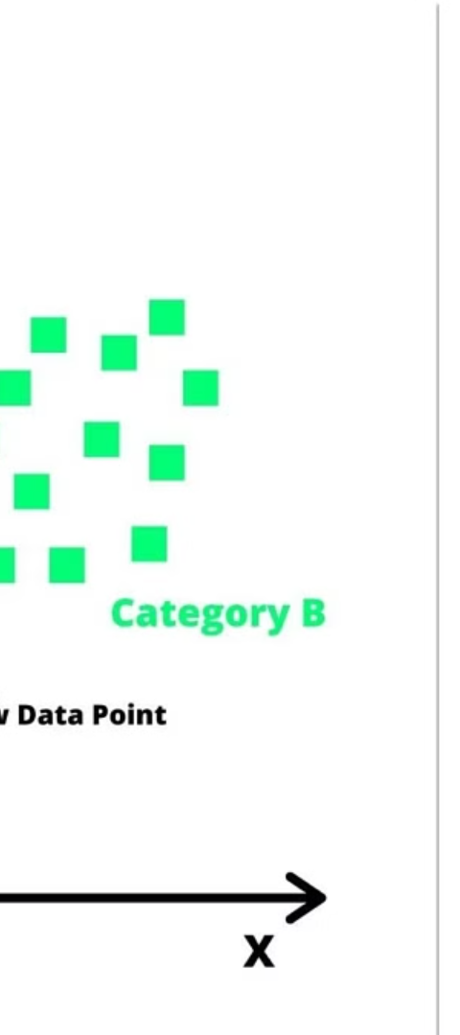

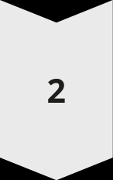
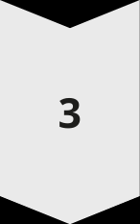
Conclusion and Key Takeaways
Versatile Algorithm
KNN can be used for both classification and regression tasks, making it a versatile tool in data analysis.
Importance of Preprocessing
Proper data preparation, including feature scaling and handling missing values, is crucial for KNN's effectiveness.
Balancing Bias and Variance
Selecting the optimal K value through cross-validation is essential to achieve the right balance between underfitting and overfitting.

